Slide 1
College Connect
Demo
Thomas Benfield (HTML/CSS dev), Jonathan Feurtado, Afif Mujibur-Rahman (developer/tester), Zachary Tissue, Julian Franzen (Database dev)

Slide 2

What is College Connect?
Small-scale social media application designed for a local college community.
Allows for students within a college community to connect with their peers in a safe and partitioned-off online environment
  Exclusively for college students, faculty, and staff
College connect hosts a forum where students can discuss a variety of topics among their peers.
Students can hold private chats in direct messages available on the profile page.
College Connect also features a roommate finder application that will allow students to find their best potential roommates based on their requested criteria.

Slide 3
Forum
The forum will allow students to communicate with each other in a standard web-forum layout.
The forum will be separated into channels and sub-channels, based on general topics (i.e School: Computer Science, Math, etc., Entertainment: Movies, Video Games, TV, etc.)
Students will be able to make a individual thread under the topics of these channels to discuss particular subjects amongst each other.
More active threads (threads with recent messages) should be shown at the top of the thread list, while less active threads show below.

Slide 4
Roommate Finder
Students can find potential roommates (and friends) through this feature.
Student can fill in information in their profile that can be used to categorize them based on their attributes
  I.e How much does cleanliness mean to you (1 to 5), do you do recreational drugs (y/n), are you a morning bird or night owl, etc.
Students submit a set of criteria and students that match the criteria will appear in search results
When a desirable student is found, the initiating student can send a Direct Message to the other student and discuss with further.

Slide 5
Current Progress
Website skeletal structure is functional
Database is functional

Slide 6
Main User Stories
I am a college student who is moving into dorms for a new semester, and I’m not comfortable with the idea of rooming with a stranger I don’t know. I would like to have a way to find a potential roommate I would get along with before settling my housing situation.
I am a student arriving on campus for the first time. I would like to connect with other students and communicate with them to make new friends or social connections. Being able to send messages on an open forum would be nice as I could meet many new people while connecting with those who have similar interests.
I’m a college student who’s very religious and looking for a roommate who shares the same beliefs to maintain a peaceful environment. I’m looking for a roommate who doesn’t have any drinking/smoking habits and keeps a clean and family-friendly environment for whenever my family visits.
I am a administrator and I have been notified of inappropriate behavior. There has been the exchange of explicit photographs and content over the schools connect system. I would like to ban the offending users for a period of time and issue a formal warning to them through the school.

Slide 7
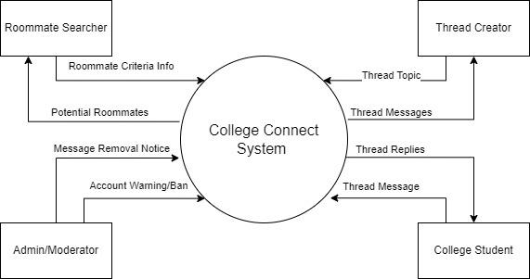
Context Diagram

Slide 8
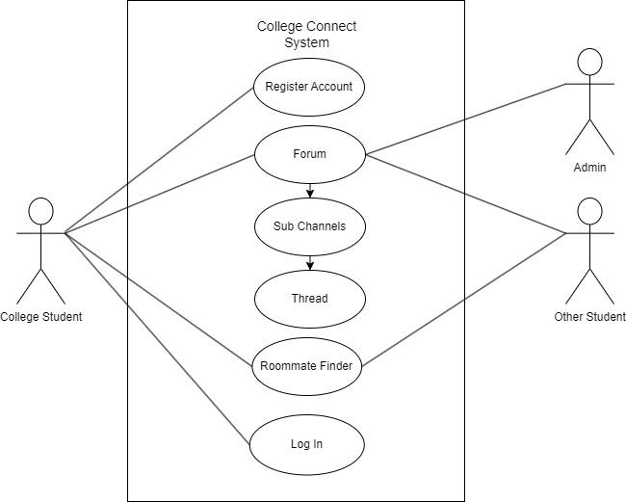
Use Case Diagram

Slide 9
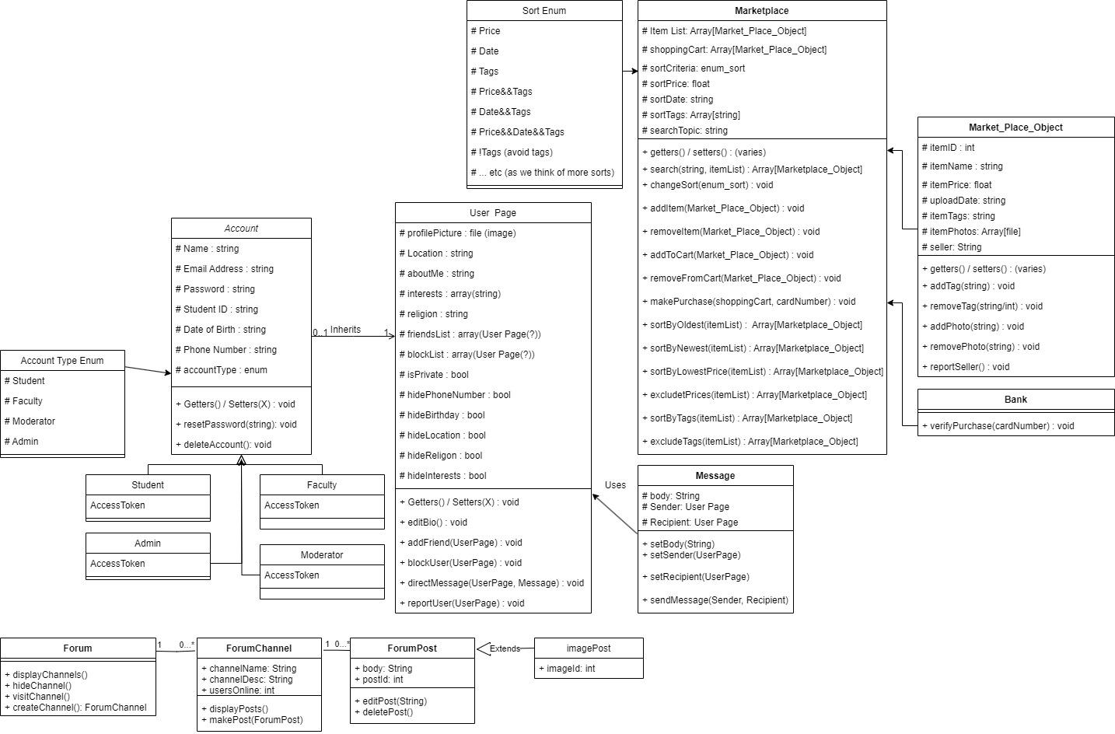
Class
Diagram

Slide 10
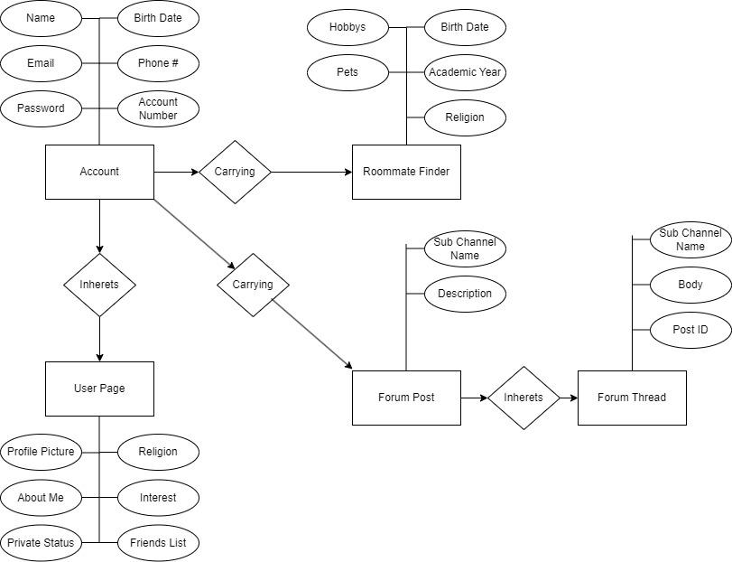
Other UML Diagrams

Slide 11
State of development using product backlog:
How many sprints are done so far, how many requirements are implemented?
  Based on our sprint schedule we have just concluded our third sprint
  Our project was slow to start though progress has been rapid in the past week or two
  Within these sprints we have come together to create a working outline of our website, CSS which works to show the intended style of our webapp, and began integrating the database into the early stages of web app functionality.

Slide 12
Lessons Learned
Marketplace feature is cut
  Due to a lack of experience with the concept among the group and along with tightening time constraints.
  As such we have learned to better communicate out strengths and determine what is realistic to implement given the skill sets we are arriving to the class with.
Roommate finder is now it’s own separate feature instead of a forum topic.
  We learned with this particular change that it is important to communicate clear requirements and project expectations before we begin to develop our ideas into a prototype.

Slide 13
Next Steps
Refine profile page design from the current placeholder
Add Roommate Finder functionality and page design
Add Forum page page design and sub-channel layout
Add Forum’s functionality in the creation of threads and replies to said threads.
Add Forum self moderation features (i.e. thread list auto-sorting by relevance)

